Slide 1
Unit1
Random scan

Slide 2
Random-Scan Display
In Random-Scan Display electron beam is directed only to the areas of screen where a picture has to be drawn.
It is also called vector displays, as it draws picture one line at time.
It can draw and refresh component lines of a picture in any specified sequence.
Pen plotter is an example of random-scan displays.

Slide 3
The number of lines regulates refresh rate on random-scan displays.
An area of memory called refresh display files stores picture definition as a set of line drawing commands.
The system returns back to first line command in the list, after all the drawing commands have been processed.
Suppose we want to display a square ABCD on the screen. The commands will be:

Slide 4

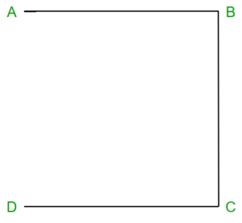
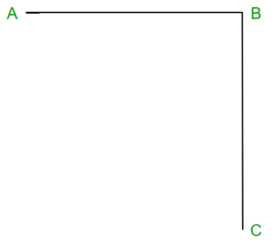
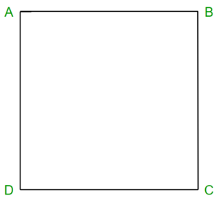
Draw a line from A to B
Draw a line from B to C
Draw a line from C to D
Draw a line from D to A

Slide 5
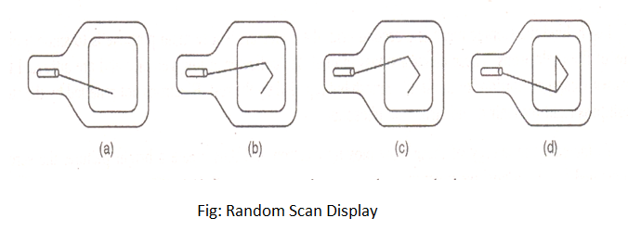
In Random Scan Display a beam of the electron is directed only to the screen areas where any picture has to be displayed or drawn on the screen. It is also termed as vector display, as it displays or draws a picture in the form of one line at a time. It can draw and refresh lines on the screen of a picture in any sequence not particularly specific.

Slide 6
Basic working of random scan display
Random scan monitors are used to draw a picture in one line at a time and are thus also referred to as vector displays.
The cathode ray tube when operates as a random scan display device directs the beam of an electron only to those areas of the screen where display or a picture has to be drawn.
To draw a picture or display it on the screen the system goes through a line or set of commands and draws each of them one at a time in a line turn by turn.

Slide 7
Random-Scan Display Processors:
Input in the form of an application program is stored in the system memory along with graphics package.
Graphics package translates the graphic commands in application program into a display file stored in system memory.
This display file is then accessed by the display processor to refresh the screen.
The display processor cycles through each command in the display file program.
Sometimes the display processor in a random-scan is referred as Display Processing Unit / Graphics Controller.

Slide 8
Picture definition is stored as a set of line-drawing commands in an area of memory referred to as the refresh display file.
To display a specified picture, the system cycles through the set of commands in the display file, drawing each component line in turn.
After all the line-drawing commands are processed, the system cycles back to the first line command in the list.

Slide 9
ADVANTAGES:
Higher resolution as compared to raster scan display.
Produces smooth line drawing.
Less Memory required.
DISADVANTAGES:
Realistic images with different shades cannot be drawn.
Colour limitations.

Slide 10
Random Scan VectorScan
In this technique, the electron beam is directed only to the part of the screen where the picture is to be drawn rather than scanning from left to right and top to bottom as in raster scan. It is also called vector display, stroke-writing display, or calligraphic display.

Slide 11
Picture definition is stored as a set of line-drawing commands in an area of memory referred to as the refresh display file. To display a specified picture, the system cycles through the set of commands in the display file, drawing each component line in turn. After all the line-drawing commands are processed, the system cycles back to the first line command in the list.
Random-scan displays are designed to draw all the component lines of a picture 30 to 60 times each second.

Slide 12
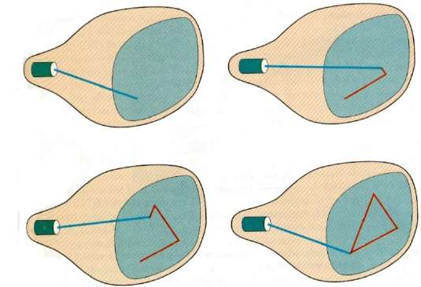

Slide 13
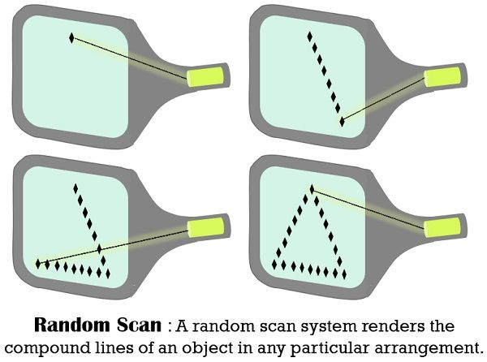

Slide 14
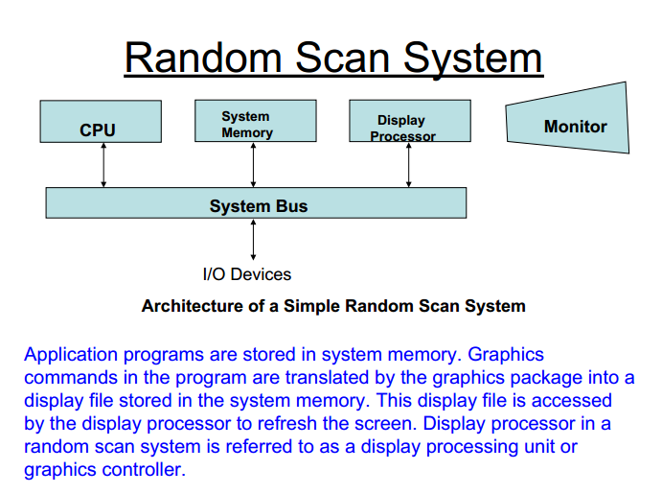

Slide 15
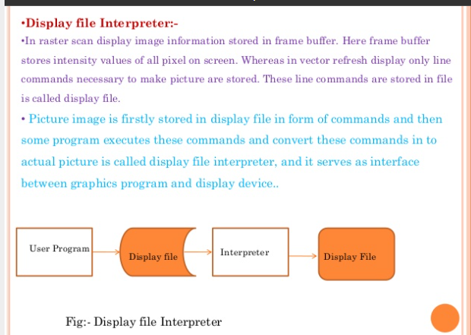

Slide 16
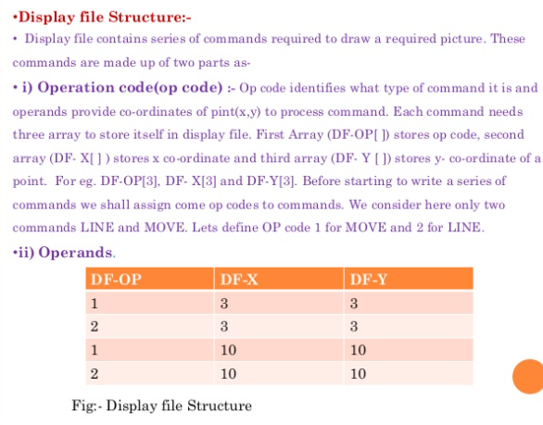

Slide 17
Some examples of raster vs random images

Slide 18
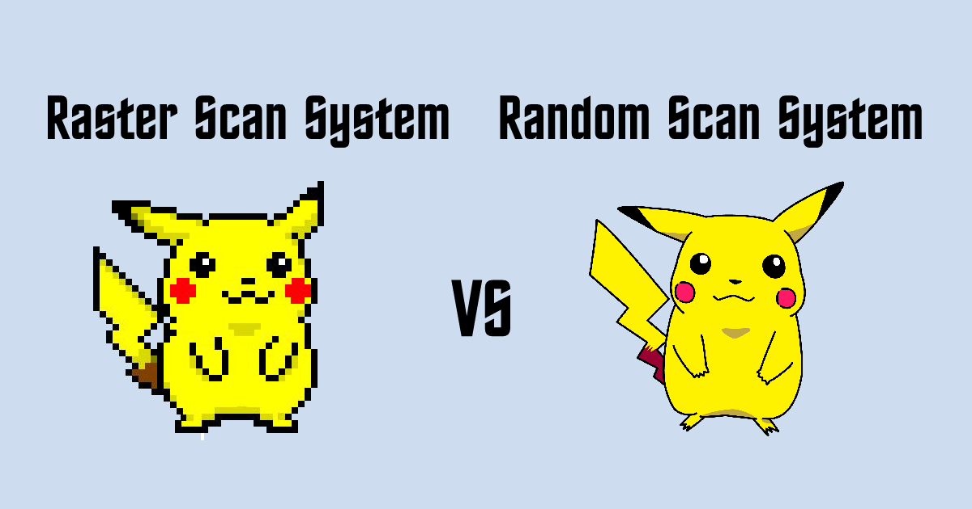

Slide 19
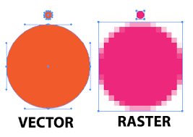

Slide 20
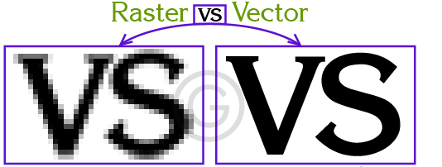

Slide 21


Slide 22


Slide 23


Slide 24
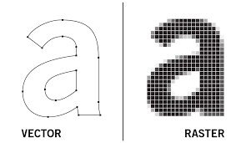

Slide 25
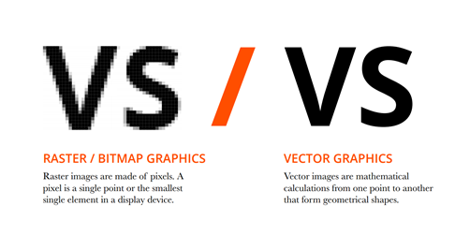

Slide 26


Slide 27
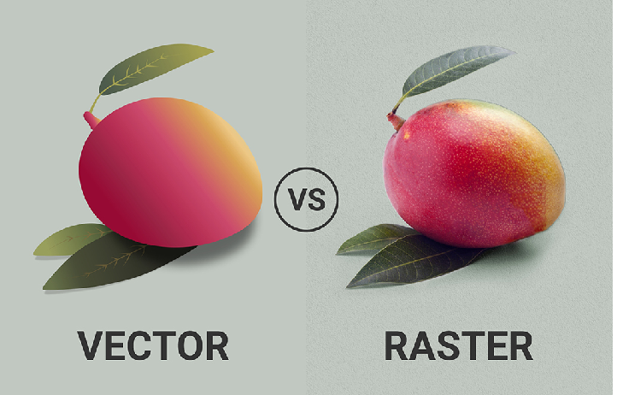

Slide 28
